Slide 1
Course Enrollment Project
Keyona Teamer
The University of Arizona Global Campus
Capstone for Computer Software Technology: CST499
Dr. Charmelia Butler
August 25, 2023

Slide 2

Software Requirements Specifications (SRS) Key Points
Every software project needs clear instructions that all parties can reference while moving through the Software Development Life Cycle (SDLC). Tsui et al. (2018) explained that the purpose of the SRS is to document what the software will do and how that will be accomplished.
The scope of the SRS is to develop a Course Enrollment Website with a MySQL Database attached. The program is designed for students and administrators. The Administrator has access to add or remove classes from the system. While the student has access to enroll, view, drop, and waitlist classes.

Slide 3
Product Functions The major functionality of the system includes: - Each user has a user ID and password. - Users can log in after registration using the user ID and password. - The online courses will include courses by semester. - There are limitations to the number of users that can enroll in a course. - A waitlist will be available when a course is full. - User can drop a course.
User Classes
The major users of the system include:
Students: They are the main actors in the system as they will be able to add, remove, and waitlist courses.
Administrators: They manage the courses available to the students.
Business Rules
Requirements of the system include:
All students must create an account.
If the student has no account, they should not have access to the system.
Data available showing course enrollment.

Slide 4
UML Design Model Fowler and Scott (2003) suggest that UML diagrams offer details about the elements and relationships associated with a system's actors, classes, and components. In this way, the models illustrate the requirements of the SRS from different system perspectives, which helps stakeholders visualize how the system will function and flow.
Use Case Diagram
Class Model Diagram
Activity Diagram
Sequence Diagram

Slide 5
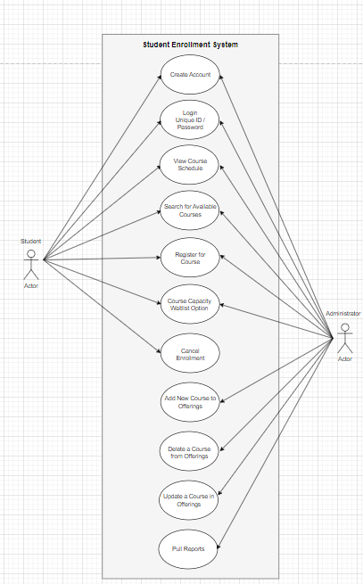
Use Case Diagram
The class diagram shown here identifies the actors, in this case, students and the administrators, and how they can interact with the system.

Slide 6
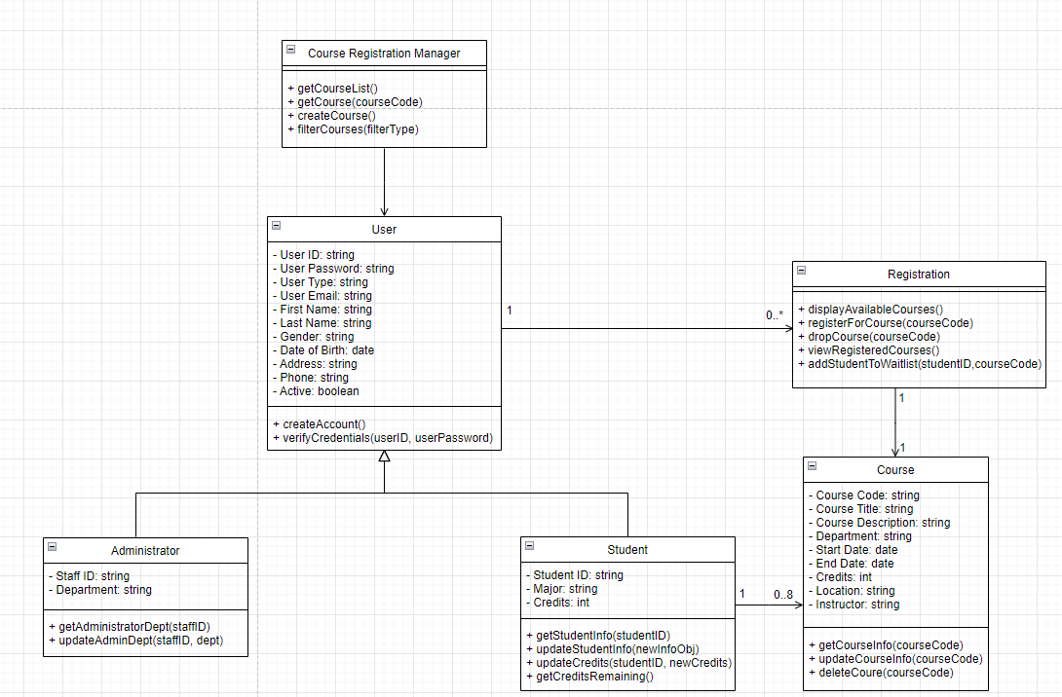
Class Diagram
This is a structural illustration of the system classes, interfaces, associations, and constraints.
The classes are users, registration, and courses. The user is a superclass to the student and administration subclasses.
In each class, there are attributes that describe the class in the first section and operations that follow in the second section of the class.

Slide 7
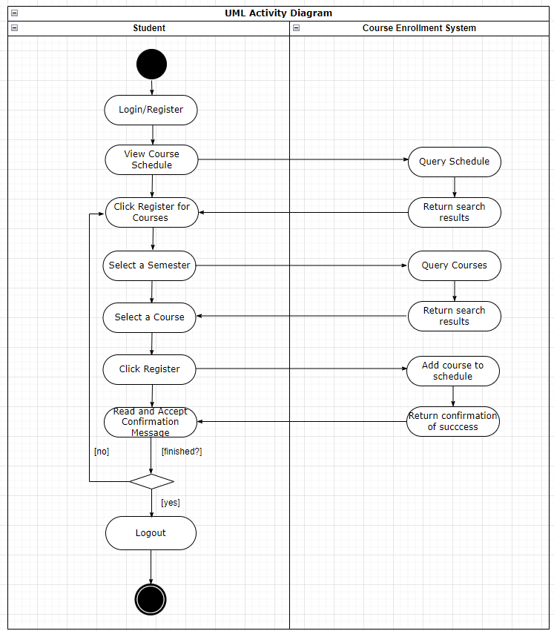
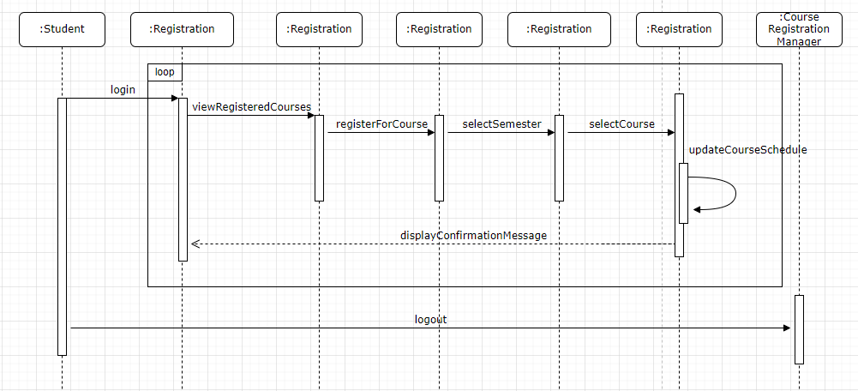
Activity Diagram
The diagram shows the flow of one activity to another activity. As one operation occurs, like the student logging into the system, they can view their courses and register for courses.
Sequence Diagram
Illustrates a message flow from one object to another object. It is easier to see the interaction between objects. For example, once the student logs in, the diagram shows that the information is tied back to the registration information; once verified, the user can access course information.

Slide 8
Landing
Login
Enrollment
Website Design
All pages were created using HTML code. Connolly and Hoar (2018) explained that HTML is a required language when creating a website. Each document uses PHP programming technology. These [ages were created with server-side source code, which is not visible to the client, just the HTML output from the scripts created for each page.
The landing page is a simple layout with bootstrap stylesheets repeated throughout the website. The user remains logged in to the page and the two below using the “ISSET ($_SESSION) method—the navigation bar links to each page.
The user remains logged in after verifying their credentials against the registration information database. The connection to the database is also linked to this PHP file. This page focuses on finding the user, verifying the credentials, and allowing or denying access.
The user has access to courses that were entered by the administrator. When the user selects the register button, the website checks with the database to see if capacity is reached. If not, the user is able to enroll. If the user needs to drop a class, they are able to select the desired course and remove the class from their profile, which is also removed from the user’s account in the database. The user can see enrolled classes under their profile page. Finally, if a course is at capacity they will receive a notice that they have been placed on a waitlist. There are lots of checks and balances in place to check the tables in the database, against the input from the website to produce the desired output.

Slide 9
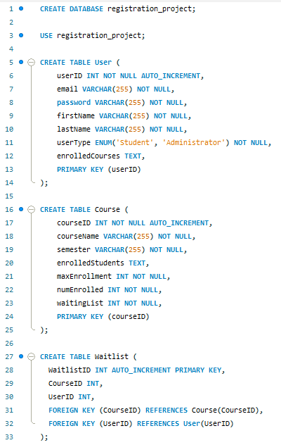
MySQL Database and Class Registration

Slide 10
Keeping the User logged into the website
Connect to the Database
$_SESSION[]
ISSET($_POST)
Get_Results():
Prepare()
Bind_Param()
Execute()
Echo
PHP Code

Slide 11
References
Connolly, R., & Hoar, R. (2018). Fundamentals of web development (2nd ed.). Pearson.
Fowler M. and Scott K. (2003). UML Distilled (3rd ed). MA: Addison-Wesley.
Tsui, F., Karam, O., & Bernal, B. (2018). Essentials of software engineering (4th ed.). Jones & Bartlett Learning.

